Slide 1
QR Code Generation
Python tutorials

Slide 2
A challenge approaches!
Install the package “qrcode” with the pil dependency

Slide 3
How did i install the package ?
CMD/Terminal Command:
pip install qrcode[pil]

Slide 4
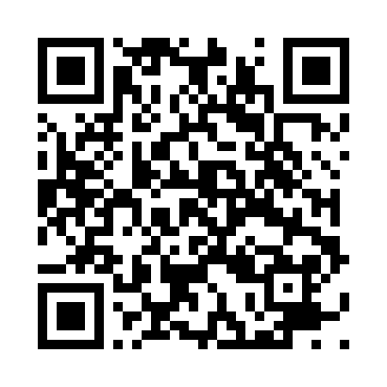
Example QR Code:

Slide 5
Qr code generation in terminal:
For windows users:
Shift + right click in the coderdojo folder on your desktop in windows
Click on open terminal/powershell/cmd/ here
Enter command: qr "Example text or link" > test.png
Go to your coderdojo folder and open “test.png”

Slide 6
How to use this in python ?
import qrcode
qr = qrcode.QRCode(
version=1,
error_correction=qrcode.constants.ERROR_CORRECT_L,
box_size=10,
border=4
)
qr.add_data("https://www.youtube.com/watch?v=dQw4w9WgXcQ")
qr.make(fit=True)
img = qr.make_image()
img.save("example_python_QR_file_inverted.png")

Slide 7
How to use this in python and display the QR code in terminal ?
import io
import qrcode
qr = qrcode.QRCode()
qr.add_data("https://www.youtube.com/watch?v=dQw4w9WgXcQ") # Put website or text here
f = io.StringIO()
qr.print_ascii(out=f)
f.seek(0)
print(f.read())

Slide 8
A Second challenge approaches!
Change the color of your qr code !
Google is very much encouraged, pypi.org may be of use !
Reminder: The python package is called qrcode !

Slide 9
Example of inverted Qr code colors
import qrcode
qr = qrcode.QRCode(
version=1,
error_correction=qrcode.constants.ERROR_CORRECT_L,
box_size=10,
border=4
)
qr.add_data("https://www.youtube.com/watch?v=dQw4w9WgXcQ")
qr.make(fit=True)
img = qr.make_image(back_color="black", fill_color="white")
img.save("example_python_QR_file_inverted.png")

Slide 10
You can also give RGB values !
img = qr.make_image(back_color=(255, 195, 235), fill_color=(55, 95, 35))

